Slide 1
Computer Science
SOCIETAL LAW
AND ETHICS
Project by:
S Shrivarshni
XI - B

Slide 2
CONTENTS
Introduction
Digital Footprint
Digital Society and Netizen
Cyber Crime
Data Protection
Intellectual Property Rights
Indian IT Act
Impact on health
Economic Benefits

Slide 3
Introduction
In recent years, the world around us has seen a lot of changes due to use of ‘Digital Technologies’.
The introduction of personal computers (PCs) and Internet followed by smartphones has brought these technologies to the common man.
While we reap the benefits of digital technologies, these technologies can also be misused.
Let’s look at the impact of these technologies on our society and the best practices that can ensure a productive and safe digital environment for us.

Slide 4
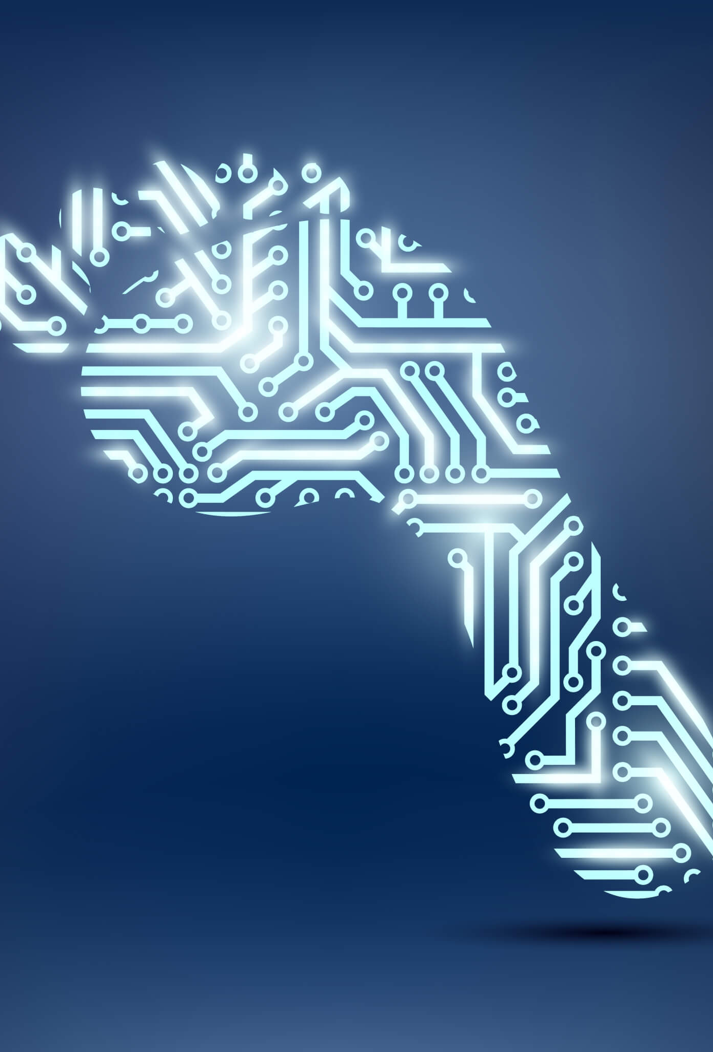
Digital Footprint
Whenever we surf the Internet using smartphones, tablets, computers, etc., we leave a trail of data reflecting the activities performed by us online, which is our digital footprint.
Our digital footprint can be created and used with or without our knowledge.
It includes websites we visit, emails we send, and any information we submit online, etc.
Such data could be used for targeted advertisement or could also be misused or exploited. Thus, it is good to be aware of the data trail we might be leaving behind.
This awareness should make us cautious about what we write, upload or download or even browse online.

Slide 5
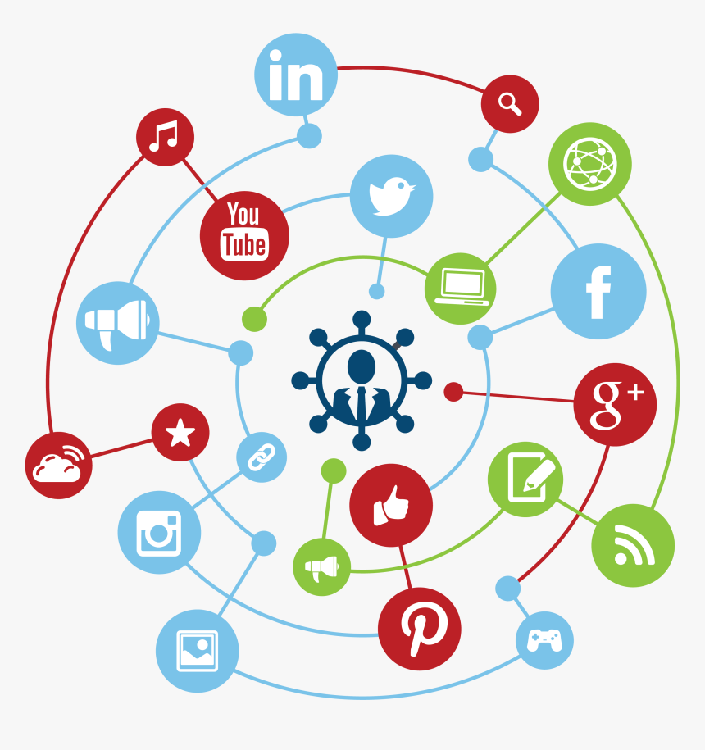
Digital Society and Netizens
As our society is inclined towards using more and more digital technologies, we end up managing most of our tasks digitally.
Digital Society reflects the growing trend of using digital technologies in all spheres of human activities.
Anyone who uses digital technology along with Internet a digital citizen or a netizen.
Being a good netizen means practicing safe, ethical and legal use of digital technology.

Slide 6
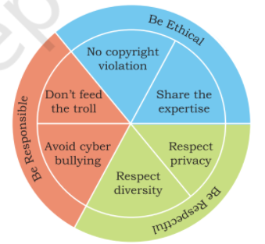
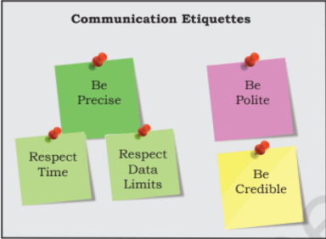
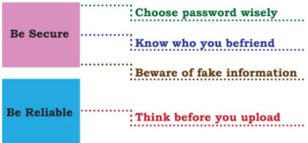
Digital Etiquettes of a Responsible Netizen
Net Etiquettes
Communication Etiquettes
Social Media Etiquettes

Slide 7
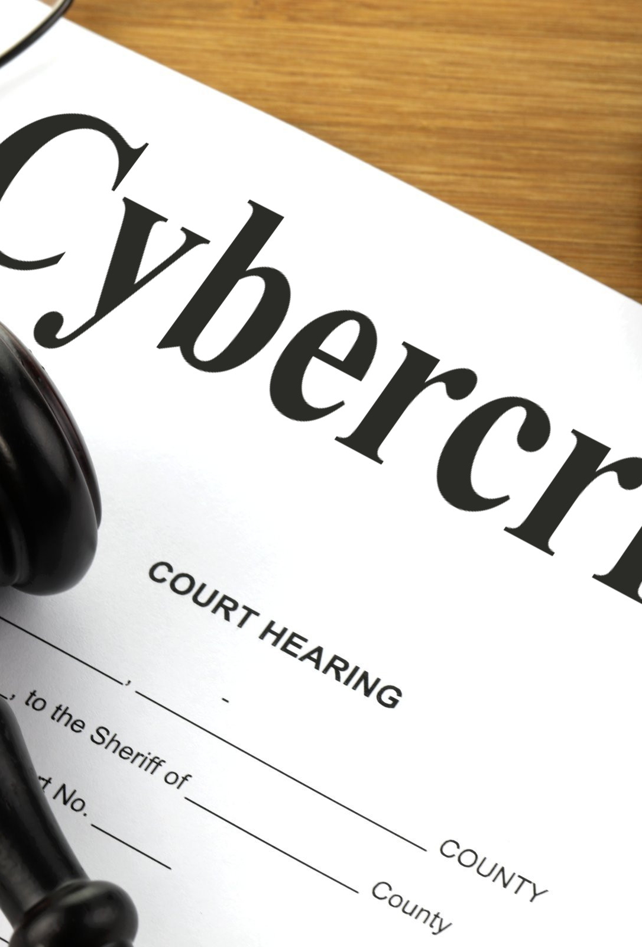
Cyber Crime
Criminal activities or offences carried out in a digital environment can be considered as cybercrime.
Cybercrimes are carried out against either an individual, or a group, or an organization or even against a country, with the intent to directly or indirectly cause physical harm, financial loss or mental harassment.
A cyber-criminal may use malicious software like Computer viruses or Malwares to perform a cybercrime.
The nature of criminal activities are alarmingly increasing day-by-day.

Slide 8
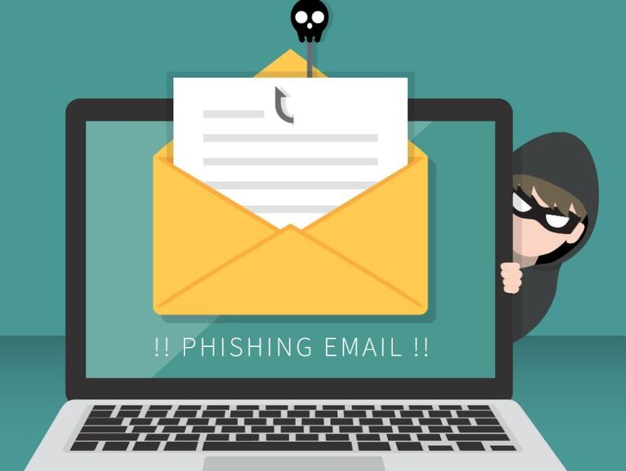
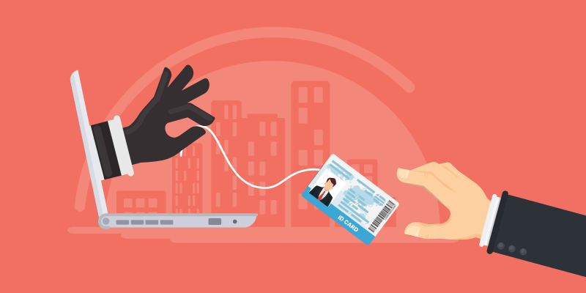
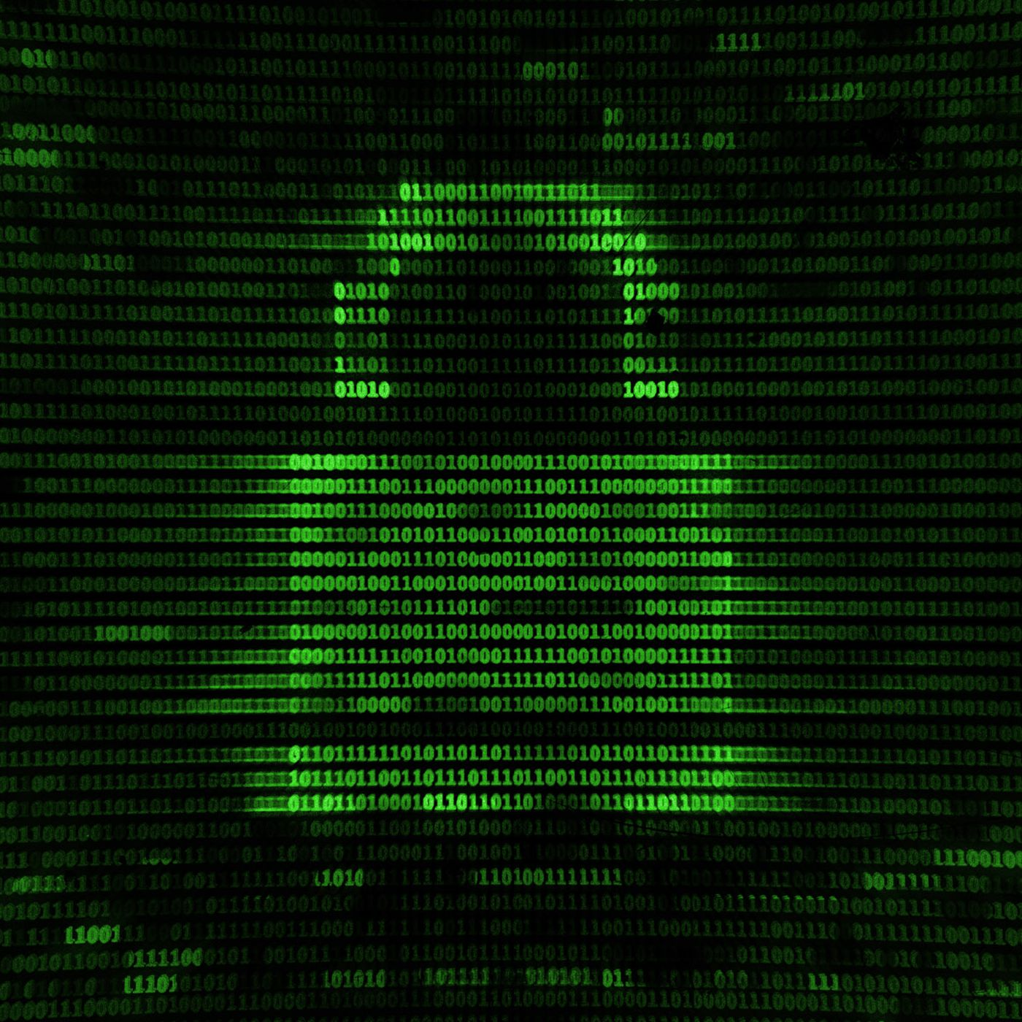
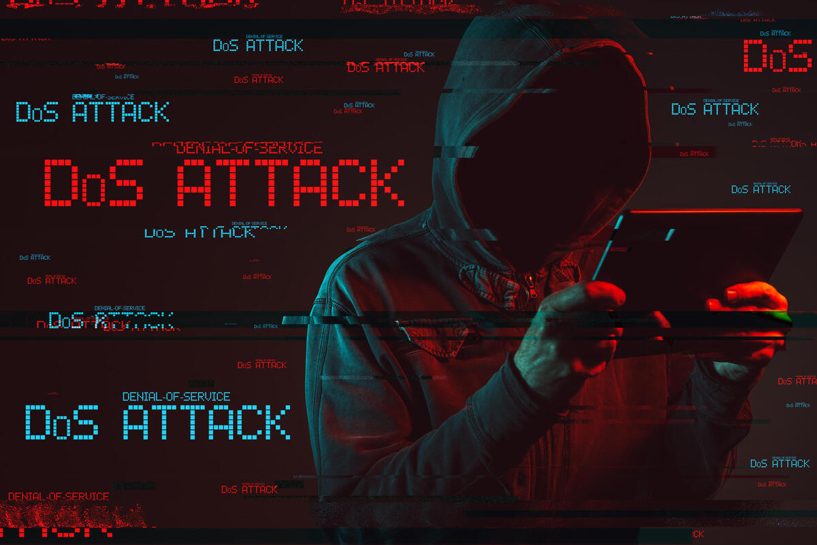
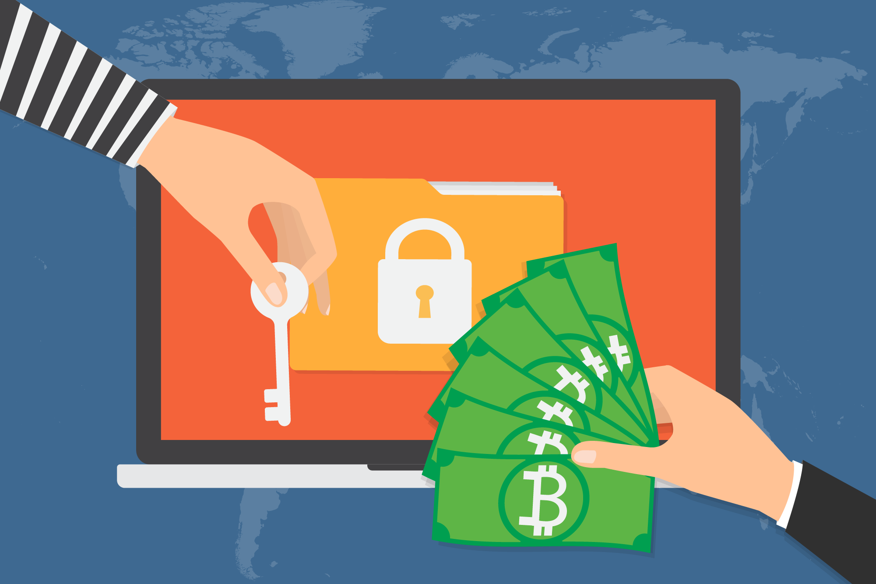
Types of Cyber-Crimes
Hacking
Phishing Emails
Identity Theft
Denial of Service
Ransomware

Slide 9
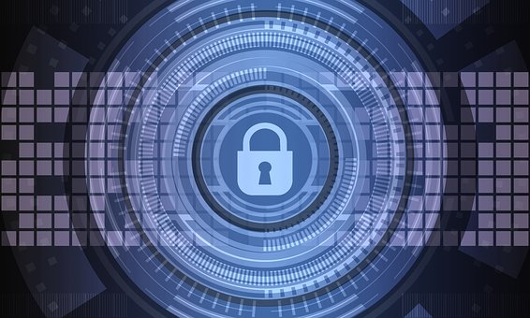
Data Protection
In this digital age, data or information protection is mainly about the privacy of data stored digitally.
Some sensitive data include biometric information, health information, financial information and other personal documents.
Privacy of sensitive data can be implemented by encryption, authentication, and other secure methods to ensure that such data is accessible only to the authorized user and is for a legitimate purpose.
All over the world, each country has its own data protection policies (laws).

Slide 10
Intellectual Property Rights
Intellectual Property refers to the inventions, literary and artistic expressions, designs and symbols, names and logos.
The ownership of such concepts lies with the creator, or the holder of the intellectual property. This enables the creator or copyright owner to earn recognition or financial benefit by using their creation or invention.
IP can be protected through
Copyrights
Patents
Trademarks
Violation of IP rights include
Plagiarism
Copyrights Infringement
Trademark infringement

Slide 11
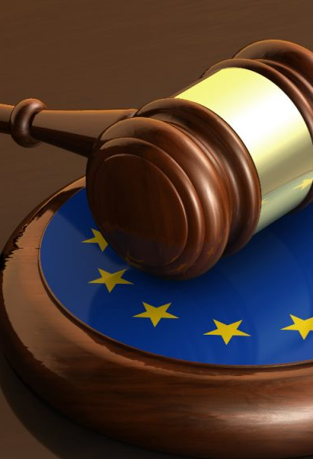
Indian IT Act
The Government of India’s Information Technology Act, 2000 (also known as IT Act), amended in 2008, provides guidelines to the user on the processing, storage and transmission of sensitive information.
The act provides legal framework for electronic governance by giving recognition to electronic records and digital signatures.
The act is needed so that people can perform transactions over the Internet through credit cards without fear of misuse.
It also empowers government departments also to accept filing, creation and storage of official documents in the digital format.

Slide 12
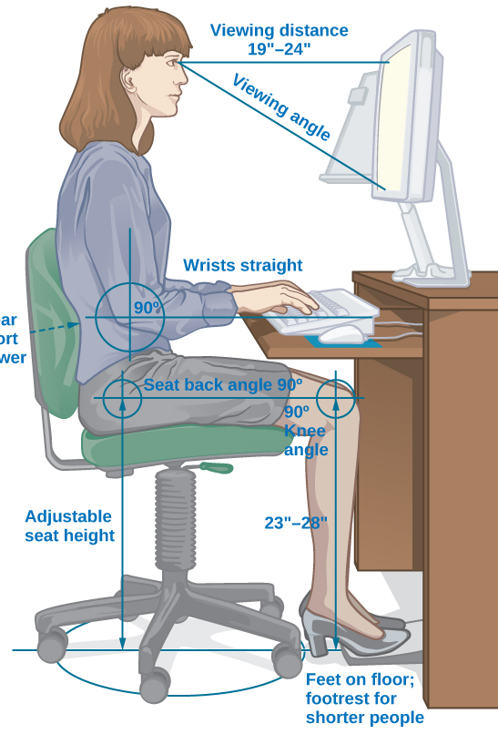
Impact on Health
As digital technologies have penetrated into different fields, we are spending more time in front of screens, be it mobile, laptop, desktop, television, gaming console etc.
These can have a negative impact on our physical and psychological well-being.
Ergonomics is a branch of science that deals with designing or arranging workplaces including the furniture, equipment and systems so that it becomes safe and comfortable for the user.
Bad posture, backaches, neck and shoulder pains can be prevented by arranging the workspace as recommended by ergonomics.

Slide 13
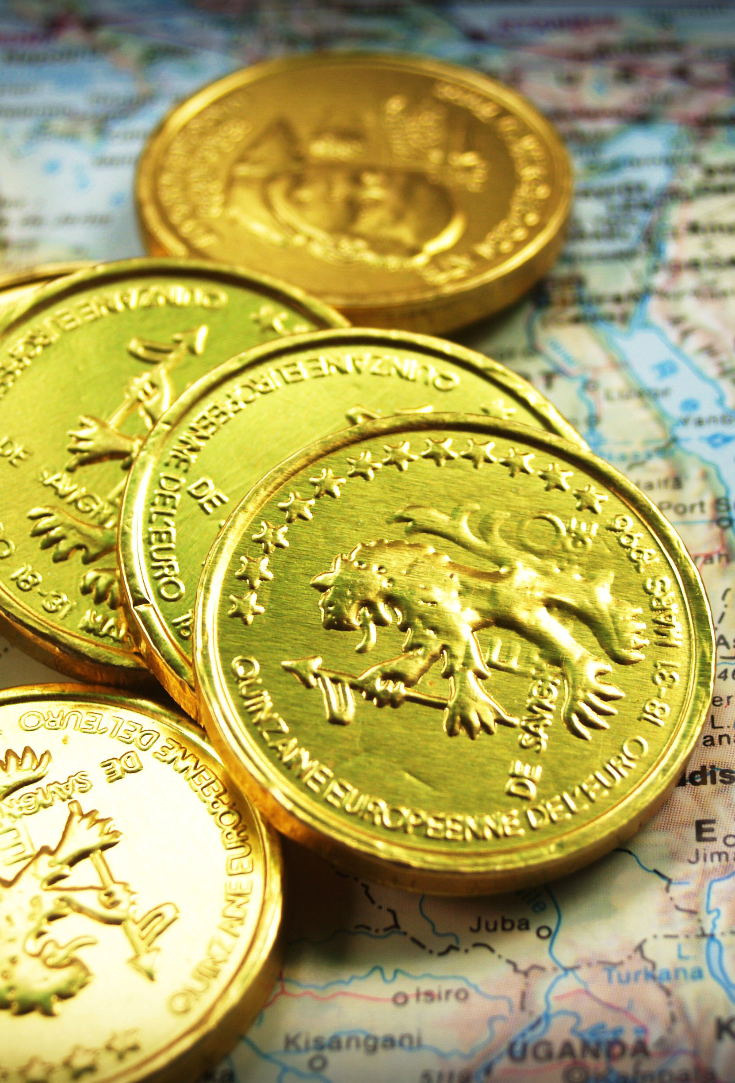
Economic Benefits
The Impact of IT on the economic sector has an exponential positive effect on the business world.
Currently with the trend shifting towards handy devices, IT has also provides support for mobile devices which has a tremendous contribution to profit.
Some of the major benefits include:
Secure Transactions
Ease and Availability
Net banking
Global Market
Currently with the trend shifting towards handy devices, IT has also provides support for mobile devices which has a tremendous contribution to profit.

Slide 14
Thankyou!

